Slide 1
Murach Ch 11 and 12 (Section 1-3)
ITCS 6160 – Database Systems

Slide 2
Group 7
NAME | NINER ID
Zi Yao Nagi | 801210585
Saranyaa Thirumoorthy | 801223117
Sumanth Kuthuru | 801166362
Bharadwaj Aryasomayajula | 801151165

Slide 3
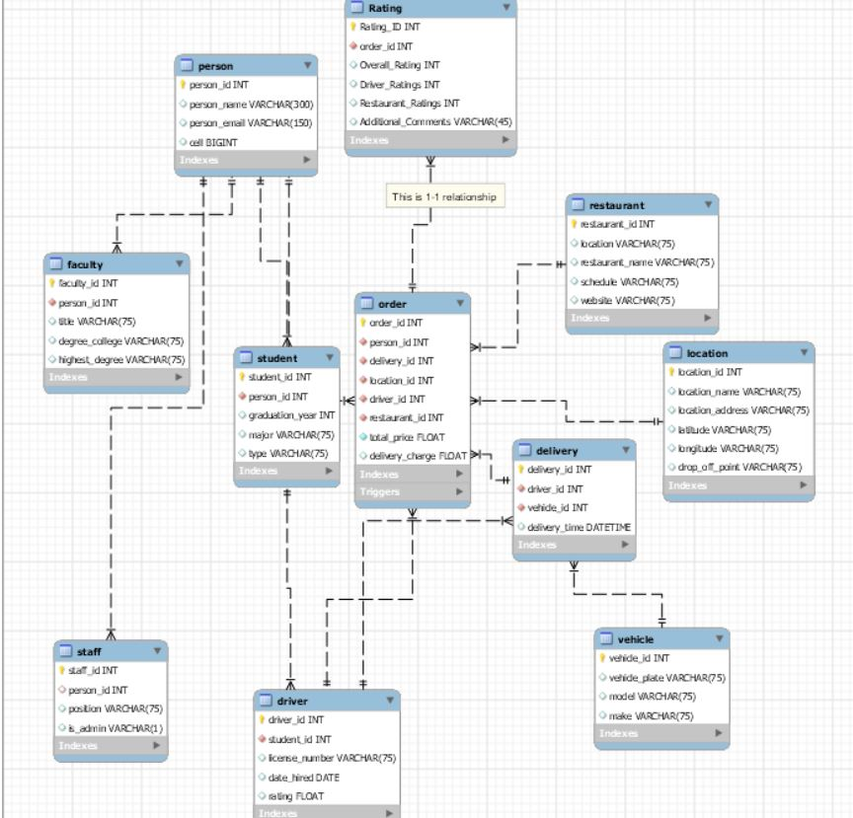
Enhanced Model (after adding ratings table)

Slide 4
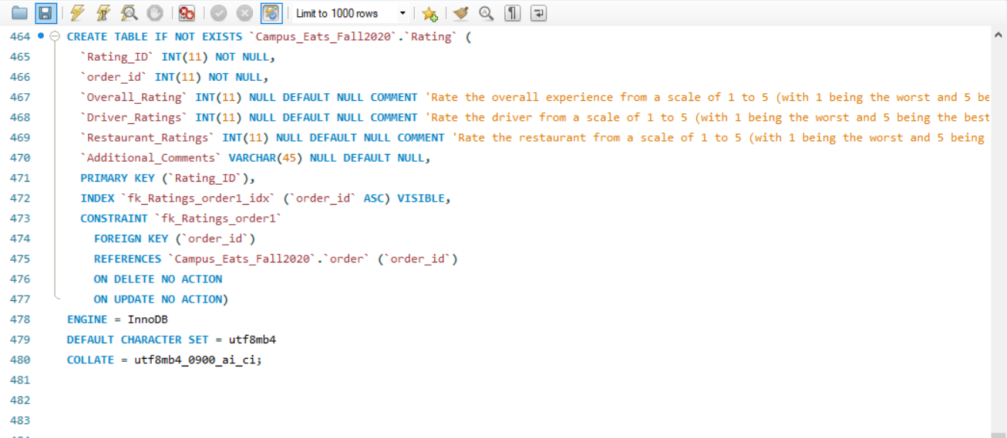
SQL code for Ratings Table
Ratings table is implemented in the campus_eats_fall2020 database.
Rating_id is the primary key and order_id is the foreign key.
It contains all the ratings for the order rating, driver rating, restaurant ratings, and overall ratings and also another column additional comments.
All ratings should be in between range 1 and 5

Slide 5
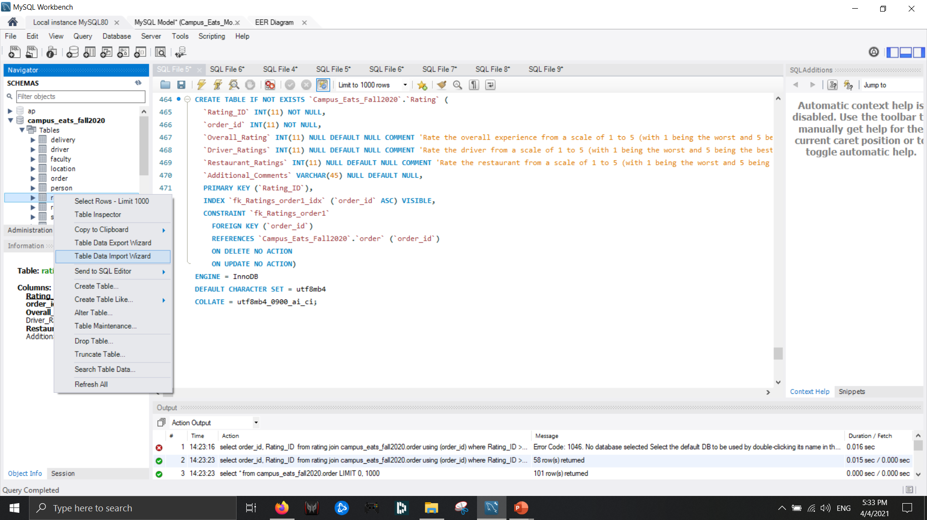
Importing test data from csv file
The ‘Table Data Import Wizard’ option is used to import the test data.
The test data should be imported from the csv file which will be attached along with the other files.

Slide 6
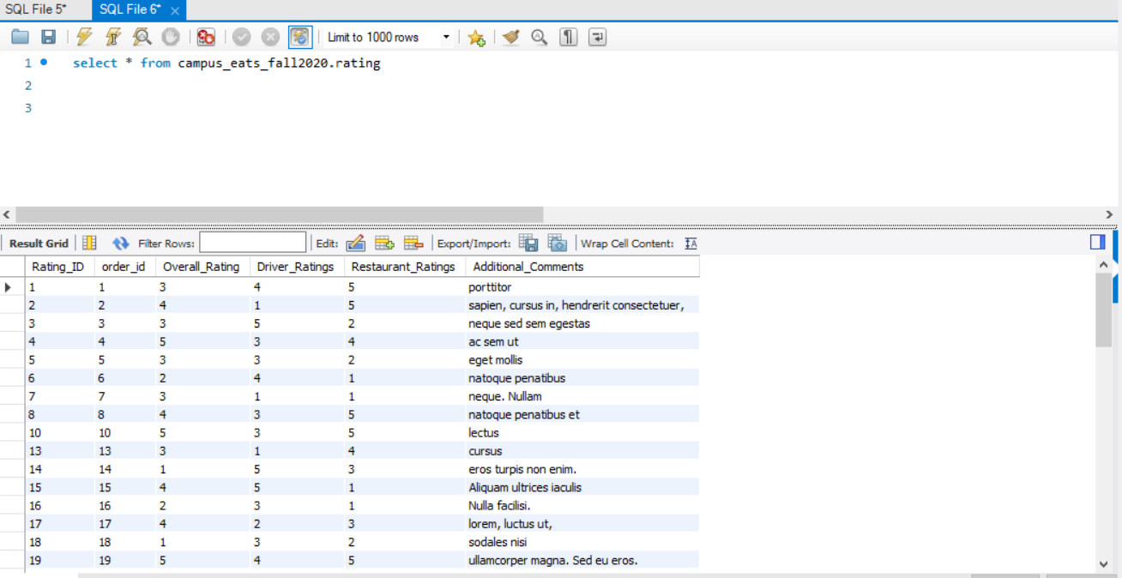
Views with output
Ratings Table
Random data in the ratings table is generated using http://www.generatedata.com to a csv file.

Slide 7
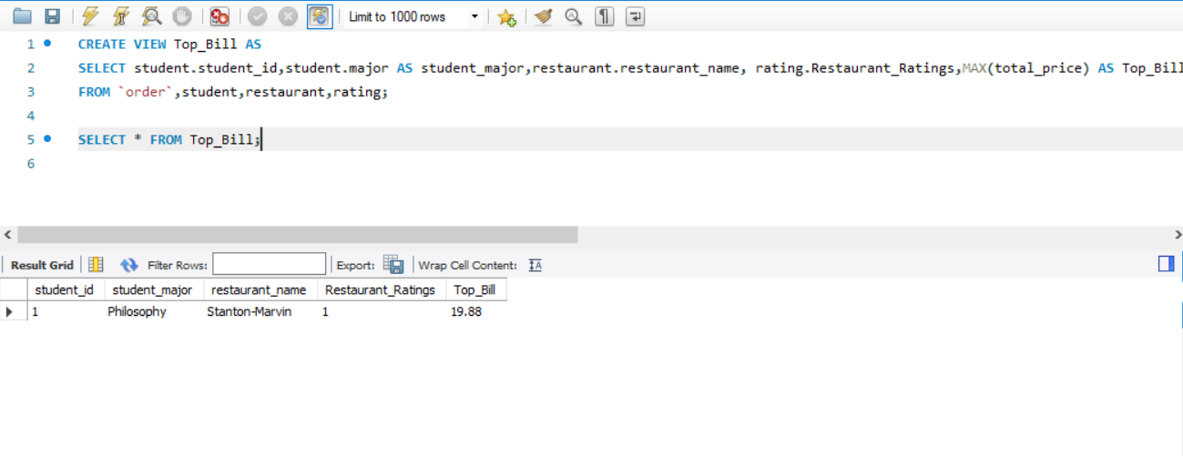
View -1
TOP BILL :

Slide 8
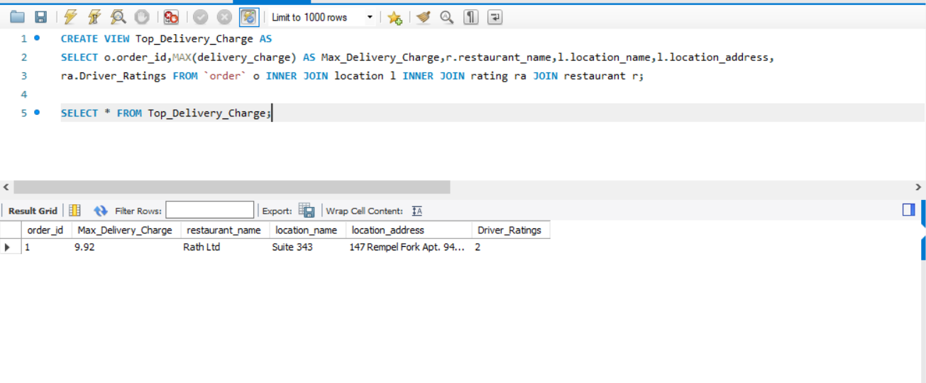
View -2
Location With Highest Delivery Charges:

Slide 9
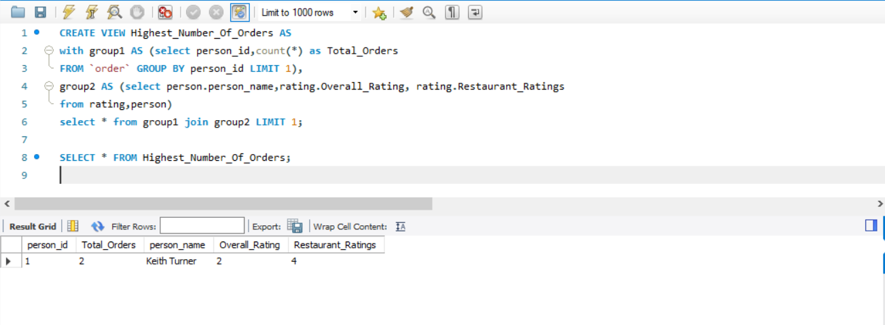
View -3
Person With Highest Number Of Orders:

Slide 10
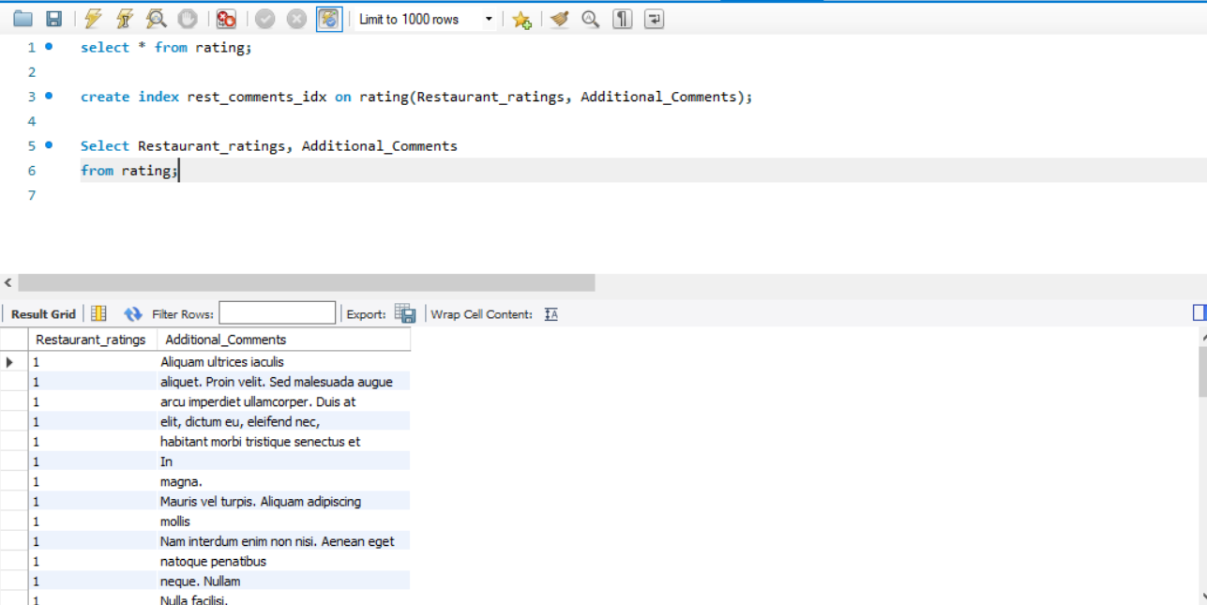
Using Indexes on ratings table

Slide 11
Thank You

